Slide 1
Vrinda Store Annual Reports 2022

Slide 2

Objective
Vrinda store wants to create an annual sale reports for 2022. So that, Vrinda can understand their customers and grow more sales in 2023.

Slide 3
Questions
Compare the sales and orders using single chart.
Which month got the highest sales and orders.
Who purchased more- men or women in 2022.
What are different order status in 2022.
List top 10 states contributing to the sales.
Relation between age and gender based on number of orders.
Which channel is contributing to maximum sales.
Highest selling category.

Slide 4
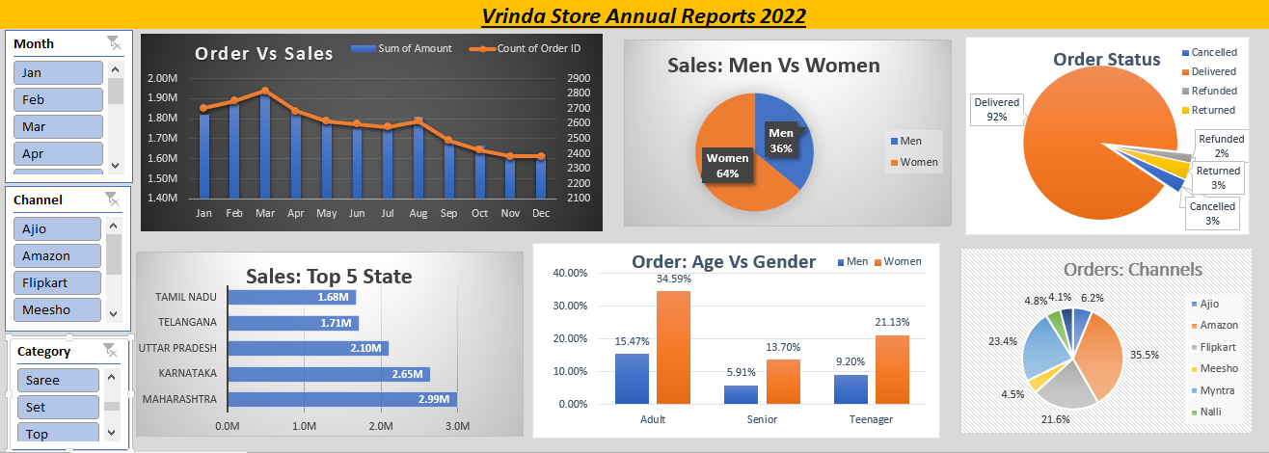

Slide 5
Insights:
Women are more likely to buy compared to men (~65%)
Maharashtra, Karnataka and Uttar Pradesh are the top 3 States(~35%)
Adult age group(30-40 yrs) is max contributing(~50%)
Amazon, Flipkart, and Myntra channels are max contributing (~80% )
Final Conclusion to improve Vrinda store sales:
Target women customers of age group (30-40 yrs) living in Maharashtra, Karnataka and Uttar Pradesh by showing ads/offers/coupons available on Amazon, Flipkart and Myntra.

Slide 6
Thank you
Gaurav
9711407364
Panwargaurav813@.com

